Slide 1

Chapter 11 (t.b.c 5.30)
Inheritance and Polymorphism

Slide 2
Objectives
To develop a derived class from a base class through inheritance (§11.2).
To enable generic programming by passing objects of derived type to a parameter of a base class type (§11.3).
To understand constructor and destructor chaining (§11.4).
To know how to invoke the base class’s constructors with arguments (§11.4).
To redefine functions in the derived class (§11.5).
To distinguish differences between redefining and overloading (§11.5).
To understand polymorphism and dynamic binding using virtual functions (§11.6).
To distinguish differences between redefining and overriding (§11.6).
To distinguish differences between static matching and dynamic binding (§11.6).
To access protected members of the base class from derived classes (§11.7).
To declare abstract classes that contains pure virtual functions (§11.8).

Slide 3
Introduction
Object-oriented programming allows you to derive new classes from existing classes. This is called inheritance. This chapter introduces the concept of inheritance. Specifically, it discusses base classes and derived classes, constructor and destructor chaining, protected data members, virtual function and polymorphism.

Slide 4
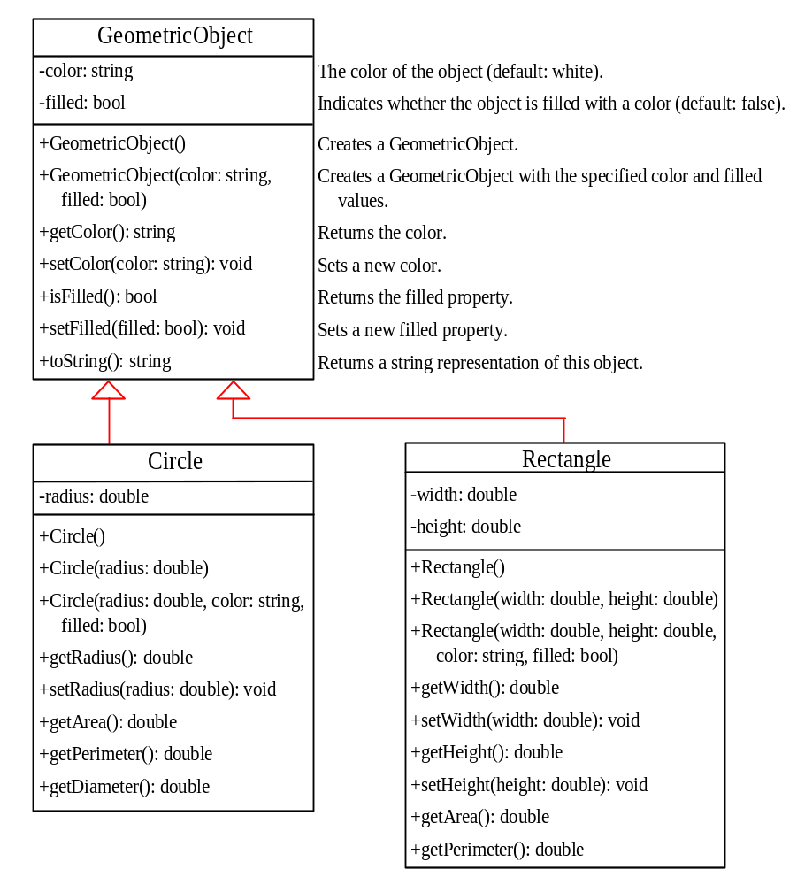
Base Classes and Derived Classes
Geometric objects have many common properties and behaviors. They can be drawn in a certain color, filled or unfilled. The Circle class inherits all accessible data fields and functions from the Geometric Object. In addition, it has a new data field, radius, and its associated get, set functions and other functions. The same for Rectangle class.
TestGeometricObject

Slide 5
Generic Programming
An object of a derived class can be used wherever an object of a based type is required. This enables a function to be used generically for a wide range of object arguments. This is known as generic programming. If a function’s parameter type is a base class (e.g., GeometricObject), you may pass an object to this function of any of the parameter’s derived classes (e.g., Circle or Rectangle).
base class object = derived class object OK
derived class object = base class object WRONG

Slide 6
Calling Base Class Constructors
A constructor is used to construct an instance of a class. Unlike data fields and functions, the constructors of a base class are not inherited in the derived class. They can only be invoked from the constructors of the derived classes to initialize the data fields in the base class. The syntax to invoke it is as follows:
DerivedClass(parameterList): BaseClass()
{
// Perform initialization
}
Or
DerivedClass(parameterList): BaseClass(argumentList)
{
// Perform initialization
}

Slide 7
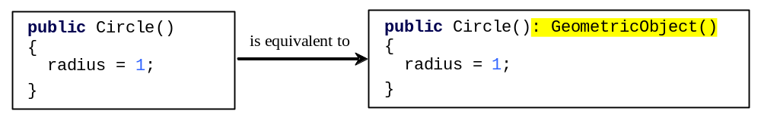
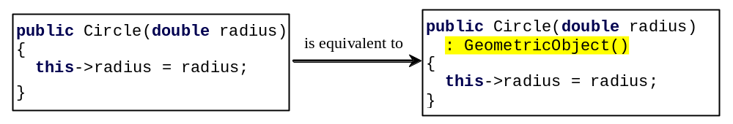
No-Arg Constructor in Base Class
A constructor in a derived class must always invoke a constructor in its base class. If a base constructor is not invoked explicitly, the base class’s no-arg constructor is invoked by default. For example,

Slide 8
Constructor and Destructor Chaining
Constructing an instance of a class invokes the constructors of all the base classes along the inheritance chain. A base class’s constructor is called before the derived class’s constructor. Conversely, the destructors are automatically invoked in reverse order, with the derived class’s destructor invoked first. This is called constructor and destructor chaining.
Constructor called sequence:
(1) base class constructor
(2) member class constructor
(3) derived class constructor
Destructor called sequence:
(1) derived class destructor
(2) member class destructor
(3) base class destructor
ChainingDemo

Slide 9
Redefining Functions
The toString() function is defined in the GeometricObject class to return a string description of a GeometricObject. You can redefine this function in the Circle and Rectangle classes to return a more specific description that is tailored to a Circle or a Rectangle object.

Slide 10
Invoke function in the base
If you wish to invoke the toString function defined in the GeometricObject class on the calling object circle, use the scope resolution operator (::) with the base class name as follows:
circle.GeometricObject::toString()

Slide 11
redefining vs. overloading
You have learned about overloading functions in §5.7, “Overloading Functions.” Overloading a function is a way to provide more than one function with the same name but with different signatures to distinguish them. To redefine a function, the function must be defined in the derived class using the same signature and same return type as in its base class.

Slide 12
Virtual Functions
Before introducing polymorphism, let us begin with an example in Listing 11.9 to demonstrate the need for polymorphism.
In C++, redefining a virtual function in a derived class is called overriding a function.
WhyPolymorphismDemo
PolymorphismDemo

Slide 13
Define Virtual Functions
To enable dynamic binding for a function, you need to do three things:
The function must be declared virtual in the base class.
The variable that references the object for the function must contain the address of the object.
Function overriding.

Slide 14
Note
If a function is defined virtual in a base class, it is automatically virtual in all its derived classes. It is not necessary to add the keyword virtual in the function declaration in the derived class.

Slide 15
static matching vs. dynamic binding
Matching a function signature and binding a function implementation are two separate issues. The declared type of the variable decides which function to match at compile time. The compiler finds a matching function according to parameter type, number of parameters, and order of the parameters at compile time. A virtual function may be implemented in several derived classes. C++ dynamically binds the implementation of the function at runtime, decided by the actual class of the object referenced by the variable.
Static matching occurs at compiler time. Dynamic binding occurs at run time.

Slide 16
use virtual functions?
If a function defined in a base class needs to be redefined in its derived classes, you should declare it virtual to avoid confusions and mistakes. On the other hand, if a function will not be redefined, it is more efficient without declaring it virtual, because it takes more time and system resource to bind virtual functions dynamically at runtime.

Slide 17
The protected Keyword
So far you have used the private and public keywords to specify whether data fields and functions can be accessed from the outside of the class. Private members can only be accessed from the inside of the class and public members can be accessed from any other classes. A protected data field or a protected function in a base class can be accessed by name in its derived classes.
VisibilityDemo
Induction visibility

Slide 18
Abstract Classes
In the inheritance hierarchy, classes become more specific and concrete with each new derived class. If you move from a derived class back up to its parent and ancestor classes, the classes become more general and less specific. Class design should ensure that a base class contains common features of its derived classes. Sometimes a base class is so abstract that it cannot have any specific instances. Such a class is referred to as an abstract class.

Slide 19
Abstract Functions
Since you can compute areas and perimeters for all geometric objects, it is better to declare the getArea() and getPerimeter() functions in the GeometricObject class. However, these functions cannot be implemented in the GeometricObject class because their implementation is dependent on the specific type of geometric object. Such functions are referred to as abstract functions. After you declare the functions in GeometricObject, GeometricObject becomes an abstract class.

Slide 20
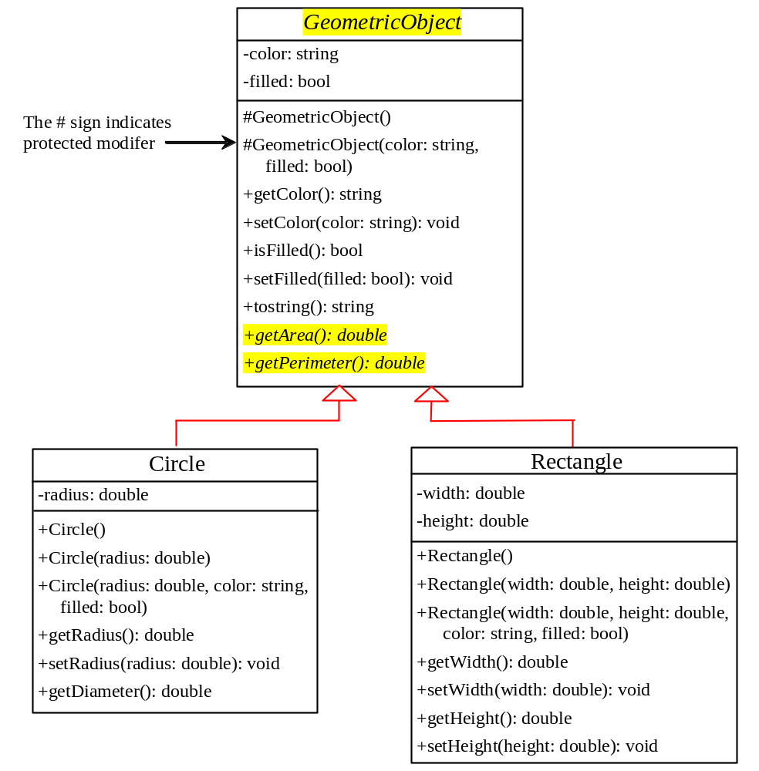
Abstract Class Example
AbstractGeometricObject.h
AbstractGeometricObject.cpp
DerivedCircle2.h
DerivedCircle2.cpp
Rectangle2.h
Rectangle2.cpp
TestGeometricObject2 .cpp

Slide 21
Chapter Summary
You can derive a new class from an existing class. This is known as class inheritance. The new class is called a derived class, or extended class. The existing class is called base class or parent class.
An object of a derived class can be used whenever an object of a based class is required. This enables a function to be used generically for a wide range of object assignments. This is known as generic programming.
A constructor is used to construct an instance of a class. Unlike data fields and functions, the constructor of a base class are not inherited in the derived class. They can only be invoked from the constructors of the derived classes to initialize the data fields in the base class.
Notes:
Immutable 不变的

Slide 22
Chapter Summary
A child or derived class always invokes its base class’s constructor. If a base constructor is not invoked explicitly, the base class no-arg constructor is invoked by default.
Constructing an instance of a class invokes the constructors of all the base classes along the inheritance chain. A base class’s constructor is called before the derived class’ constructor. Conversely, the destructors automatically are invoked in reverse order, with the derived class’ destructor invoked first. This is called constructor and destructor chaining.
A function defined in the base class may be redefined in the derived class. A redefined function must match the signature an return type of the function in the base class.
Notes:
Immutable 不变的

Slide 23
Chapter Summary
A virtual function enables dynamic binding. A virtual function often is defined in the derived classes. The compiler decides which function implementation to use dynamically at run time.
A protected data field or a protected function in a base class can be accessed by name in its derived classes.
A pure virtual function also is called an abstract function. If a class contains a pure virtual function, the class is called an abstract class. You can not create instances from an abstract class, but abstract classes can be used as data types for parameters in a function to enable generic programming.
Notes:
Immutable 不变的

